Slide 1


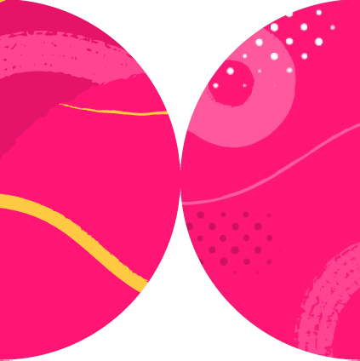

Playwright
Integration with Various Test Frameworks

Slide 2
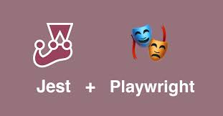

Slide 3

Introduction
Installing
Adding TypeScript
Adding Jest
Writing simple Playwright tests
Running on all browsers
Adding globalTypes.ts
Debugging our test
Summary
Overview

Slide 4
jest-playwright
Multi-browser and device (like iPhones with given screen sizes) support
jest-dev-server integration which can start your webserver like create-react-app before running the tests
expect-playwright integration which provides common expect helper functions

Slide 5
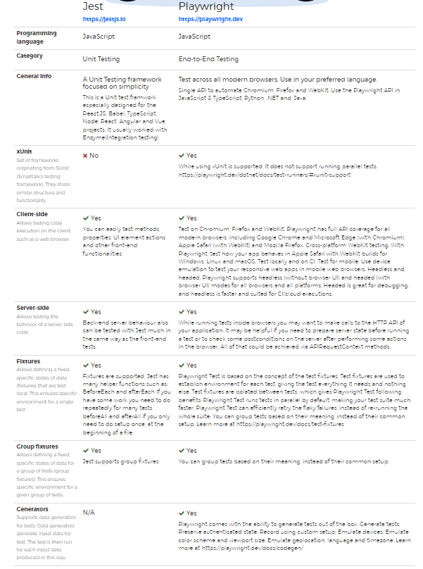
Summary

Slide 6


Slide 7
Introduction
Initializing a Node.js project
Adding Playwright
Adding Mocha
Adding TypeScript
Adding @types/node
Adding TypeScript Execute (tsx)
Creating a .mocharc.json
Updating test script in package.json
Writing a simple Playwright test
Running your test
Summary
Overview

Slide 8
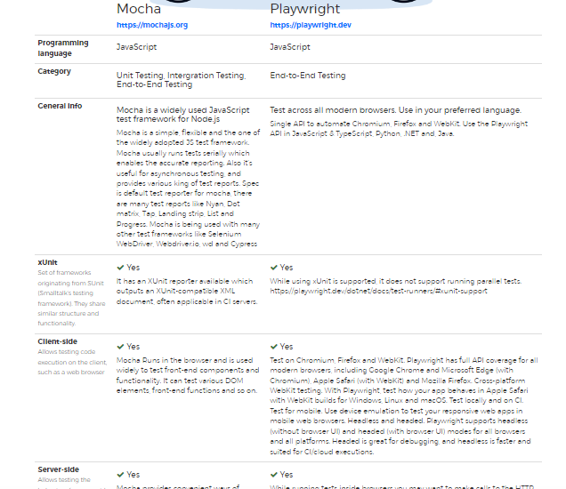
Summary

Slide 9
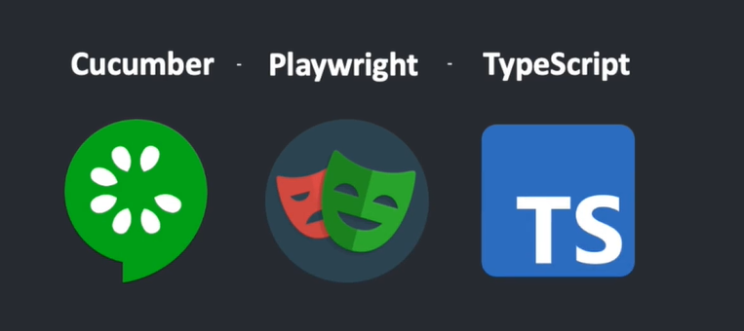

Slide 10
How to Integrate Cucumber With Playwright
Introduction
Create a folder e.g playwright_cucumber
What is Cucumber ?
Set up Cucumber With Playwright
Create feature file
Create a runner file
Script for npm test
First test run
Create Step definition
Summary
Overview

Slide 11
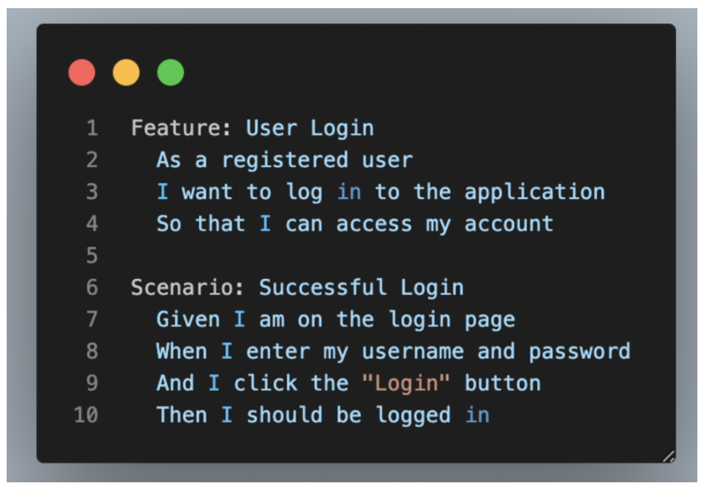

Slide 12
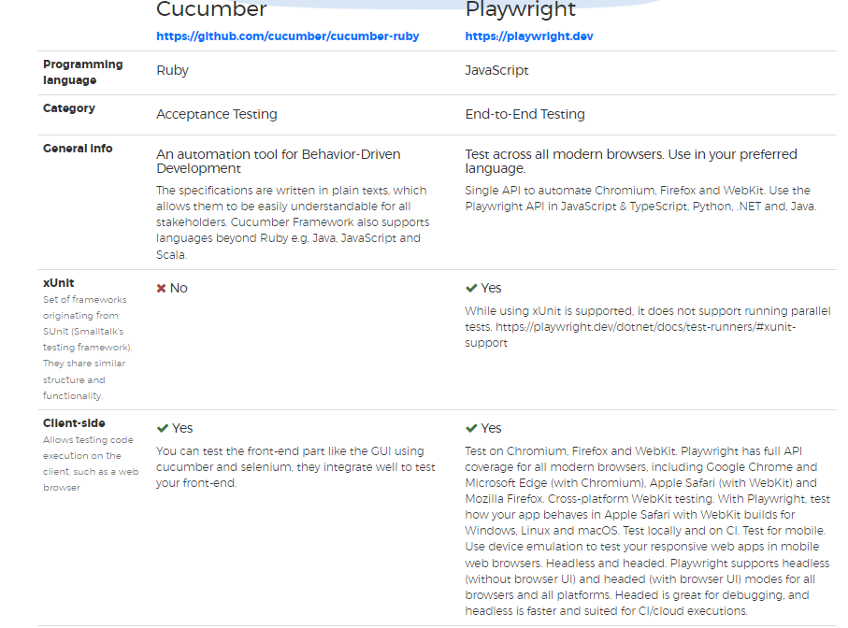
Summary

